Slide 1





Gentech's Path to Process Excellence: Proposal Creation Optimization
Mithun Nair
Notes:
Mithun

Slide 2


Company Overview
Gentech | Gentech is a global market leader, offering software, hardware, and integrated business solutions worldwide.
Annual Revenue | $60 Billion
Employees | 150,000 employees
Regions | North America, Asia Pacific, South America, EMEA and Japan
CEO | Elliot Smith
Notes:
Mithun

Slide 3


Voice of Customers
Extended proposal delivery times are resulting in sales losses, while the support team’s skill gaps hinder prompt decision-making.
Notes:
Mithun

Slide 4



Economic Bottleneck
Gentech faced a significant revenue decline of 18% in the last two years, primarily attributed to prolonged cycle times in the Proposal Creation Process. This inefficient process is marked by excessive approval steps, and redundant tasks, leading to increased operational time, foregone revenue, and diminished customer satisfaction. The aim of this project is to optimize the Proposal Creation Process, with a target of reducing cycle times by 15%, ultimately driving operational excellence, cost reduction, and market reinvigoration.
Notes:
Mithun

Slide 5

Objective & Scope
Objective
Scope
Within Scope: Sellers, BSS, Proposal Support Managers, Product Design Teams, Pricing Teams, and the Brand Managers collaborate to achieve a minimum of 15% reduction in the overall cycle time for each proposal, spanning all geographic locations and brands.
Out of Scope: Effective Conversion of a Proposal.
Revamp the proposal process by eliminating inefficiencies and redundant tasks to enhance operational cycle time by 15%.
Notes:
Mithun

Slide 6
Operational Metric
Cycle Time
Defect
The time taken from identifying a sales opportunity to submitting a proposal to the client.
Proposal creation taking longer than 35 days.
Notes:
Mithun

Slide 7
Efficiency Beyond Borders: Gentech's Proposal Creation Process Enhancement
Business Problem: Gentech is facing a significant revenue decline of 18% in the last two years, primarily attributed to prolonged cycle times in the Proposal Creation Process. This inefficient process is marked by excessive approval steps, and redundant tasks, leading to increased operational costs, foregone revenue, and diminished customer satisfaction. The aim of this project is to optimize the Proposal Creation Process, with a target of reducing cycle times by 15%, ultimately driving operational excellence, cost reduction, and market reinvigoration. |  | Executive Sponsor Grace Monroe Black Belt Champion Jeff Hugh
Objective and Scope Objective: Revamp the proposal process by eliminating inefficiencies and redundant tasks to enhance operational cycle time by 15%. Within Scope: Sellers, BSS, Proposal Support Managers, Product Design Teams, Pricing Teams, and the Brand Managers collaborate to achieve a minimum of 15% reduction in the overall cycle time for each proposal, spanning all geographic locations and brands. Out of Scope: Effective Conversion of a Proposal. |  | Team Members Tim Li Priyanka Koganti Lakshmi Gayathri Raghavaraju Mithun Nair
Process Owner: Grace Monroe Black Belt: Jeff Hugh | Investment: $750,000 RISKS Unexpected Delays in Project Implementation | Team Members Tim Li Priyanka Koganti Lakshmi Gayathri Raghavraju Mithun Nair
DMAIC | Start / End | Operational Metric | Baseline | Target
Define | 01/11-07/11 | Cycle Time: The time taken from identifying a sales opportunity to submitting a proposal to the client. Defect: Whenever the Cycle time is more than 35 days. | 31.62 Days | 26.87 Days
Measure | 08/11-14/11
Analyze | 15/11-21/11 | Expected Benefits |  | Projected Savings
Improve | 22/11-28/11 | Hard Benefits: Increase the total revenue of the business by a minimum of 18% Soft Benefits: Reduced cycle times have the potential to draw in new bid opportunities and simultaneously lower operational costs. Strategic Benefits: Enhanced market share leads to a competitive advantage over rival Companies. |  | $1.2 Billion
Control | 29/11-05/12
Notes:
Mithun

Slide 8
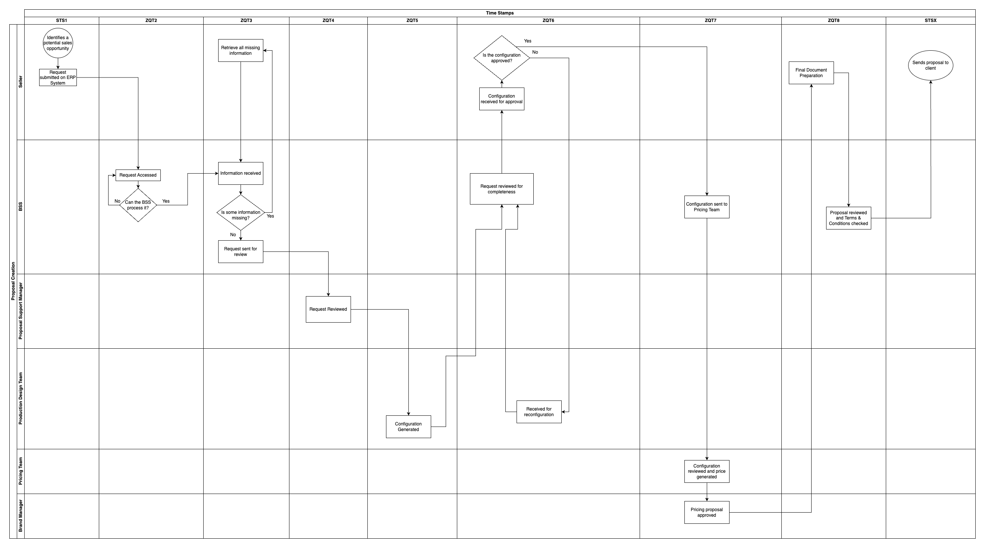
Current Process Map

Slide 9
D.P.M.O
Defects: A proposal is considered a defect if the total time taken to complete it is more than 35 days.
Total Number of Opportunities: | 75,000
Defects | 21,709
DPMO | 0.2810 * 10^6
Current Process Sigma Level | 2.082841507 (assuming 1.5 sigma level shift)
Notes:
Mithun

Slide 10
Analysis

Slide 11

Notes:
[Tim]: This is the bid size PowerBI dashboard embed, please use your personal office account to view it

Slide 12
Notes:
[Tim]: This is the operation Days PowerBI dashboard embed, please use your personal office account to view it

Slide 13
Notes:
[Tim]: This is the Feed back PowerBI dashboard embed, please use your personal office account to view it

Slide 14
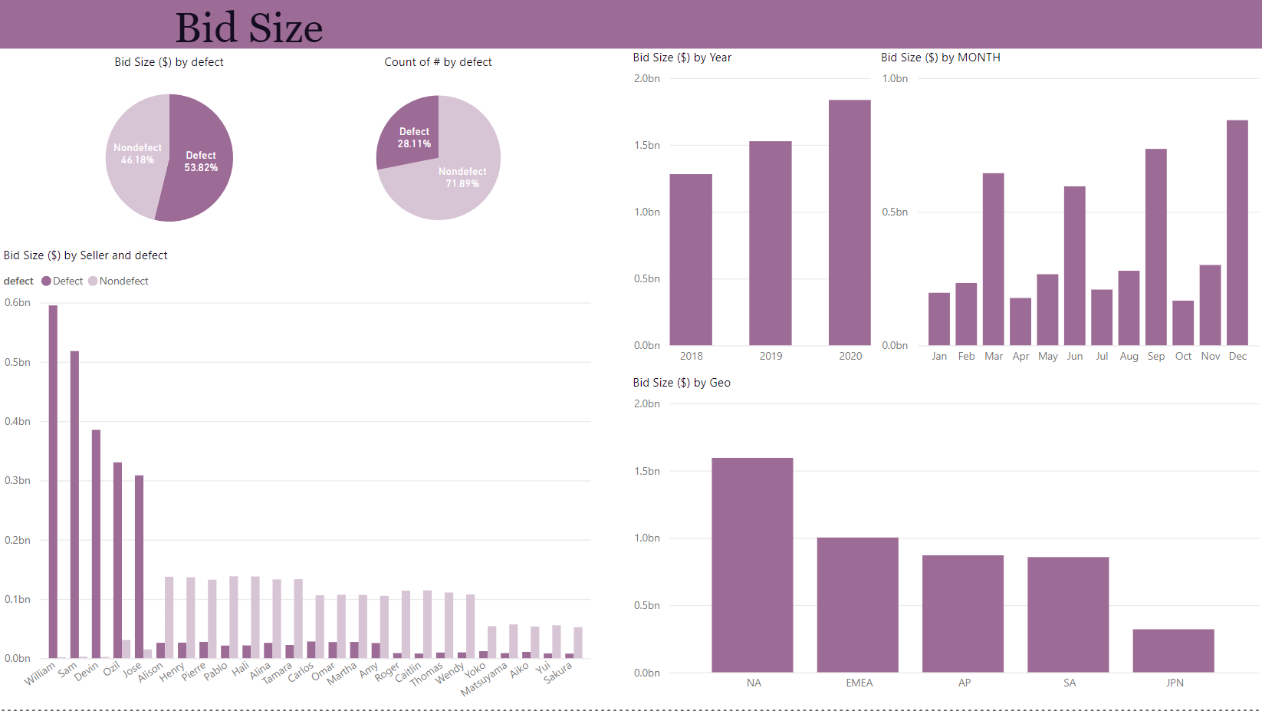
Notes:
Tim-Li

Slide 15
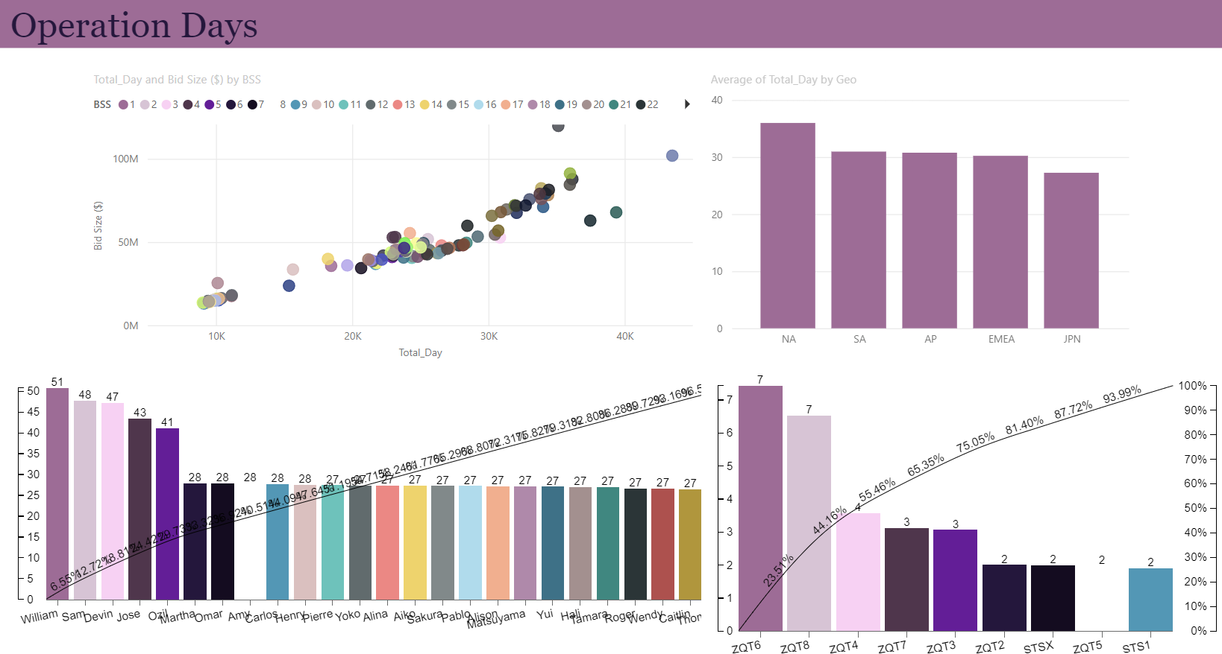
Notes:
Tim-Li

Slide 16
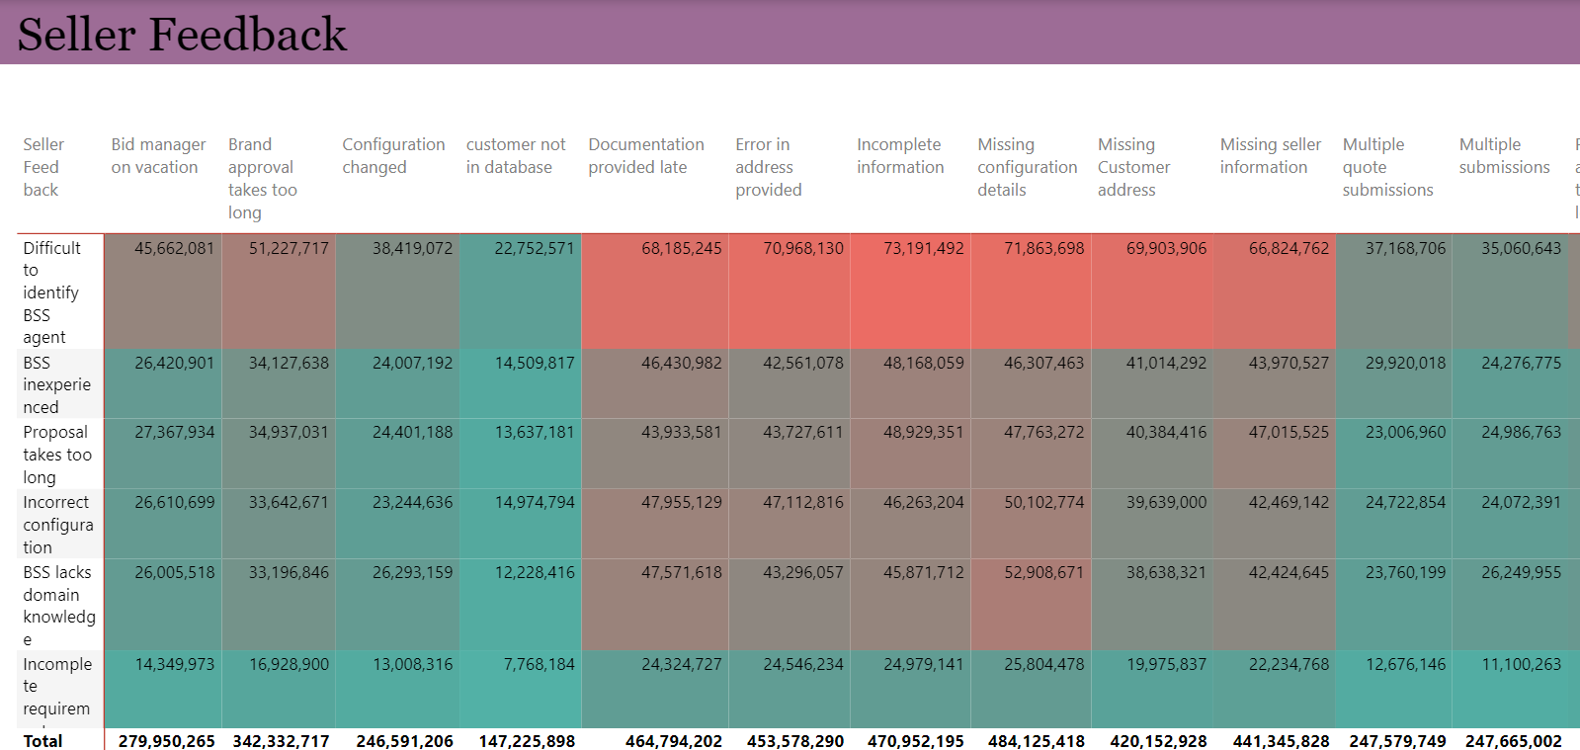
Notes:
Tim-Li

Slide 17
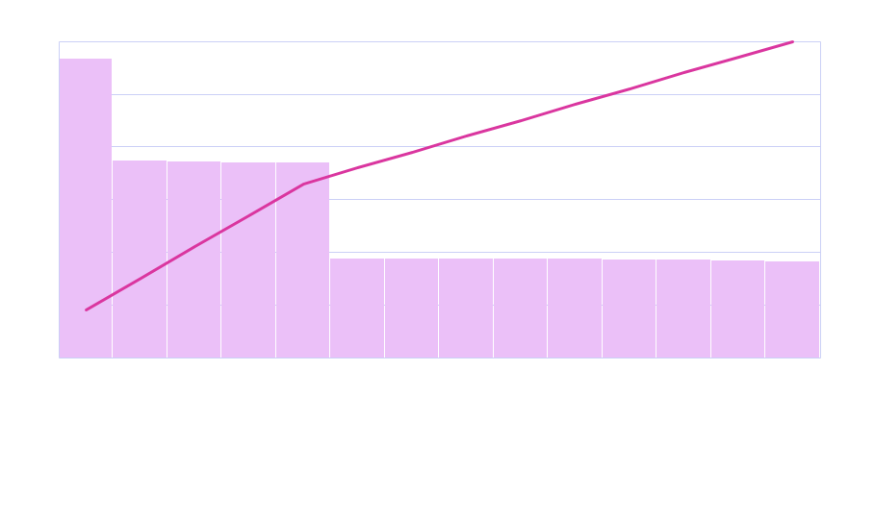

Slide 18
Difficult to identify BSS Agent, Incorrect configuration, BSS lacks domain knowledge, Proposal takes too long, BSS inexperienced is contributing to the majority of the issue based on seller feedback.
Notes:
Tim-Li

Slide 19
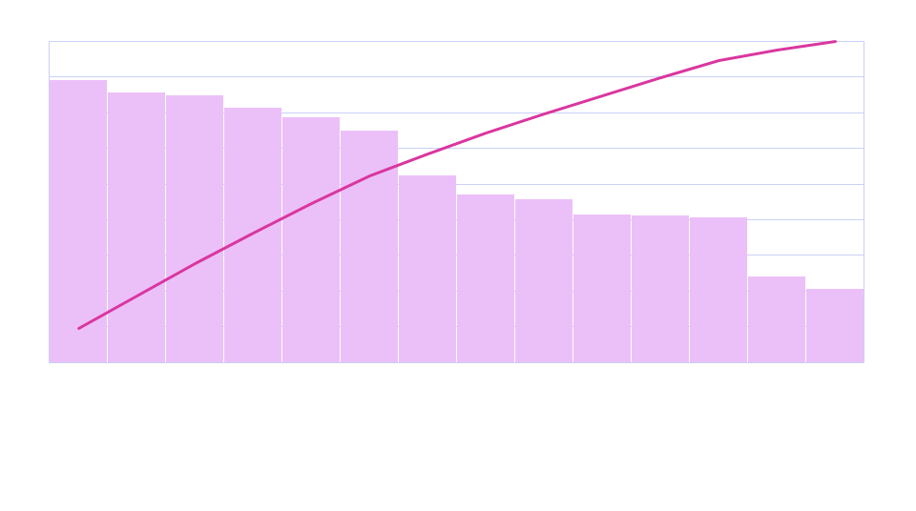

Slide 20
Missing Configuration Details, Incomplete Information are the major causes based on BSS feedback that are the reason for increased cycle time

Slide 21
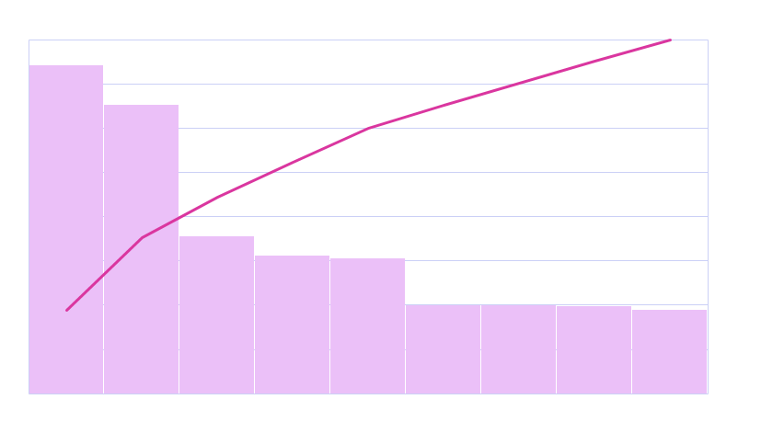

Slide 22
ZQT6,ZQT8 are contributing to the 80 percent of the issue I,e delay in time cycle

Slide 23
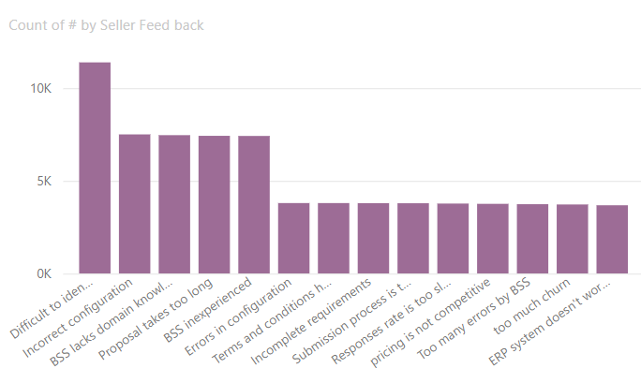
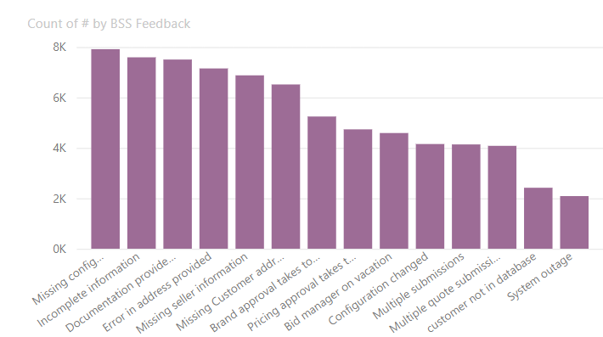
Major Concerns by sellers:
1. Difficulty to identify the right BSS agent is the major issue that is causing an increase time cycle.
Major Concerns by BSS:
1.Missing configuration details are the major issue that is causing the increase in time cycle.
Notes:
Tim- Li

Slide 24
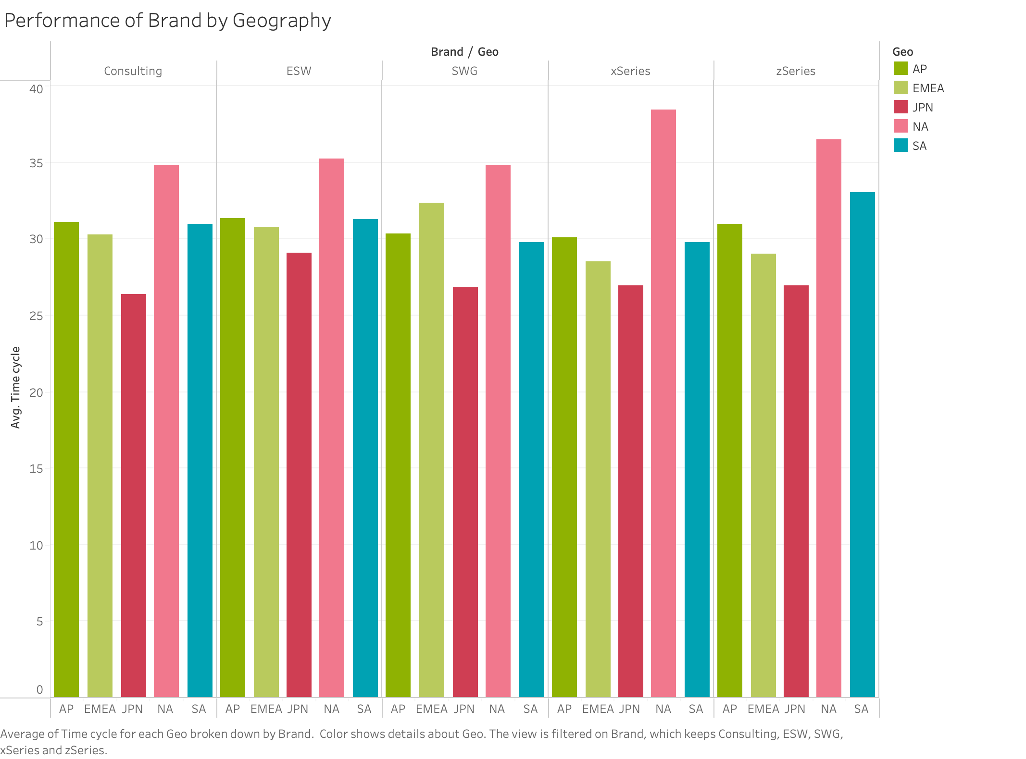
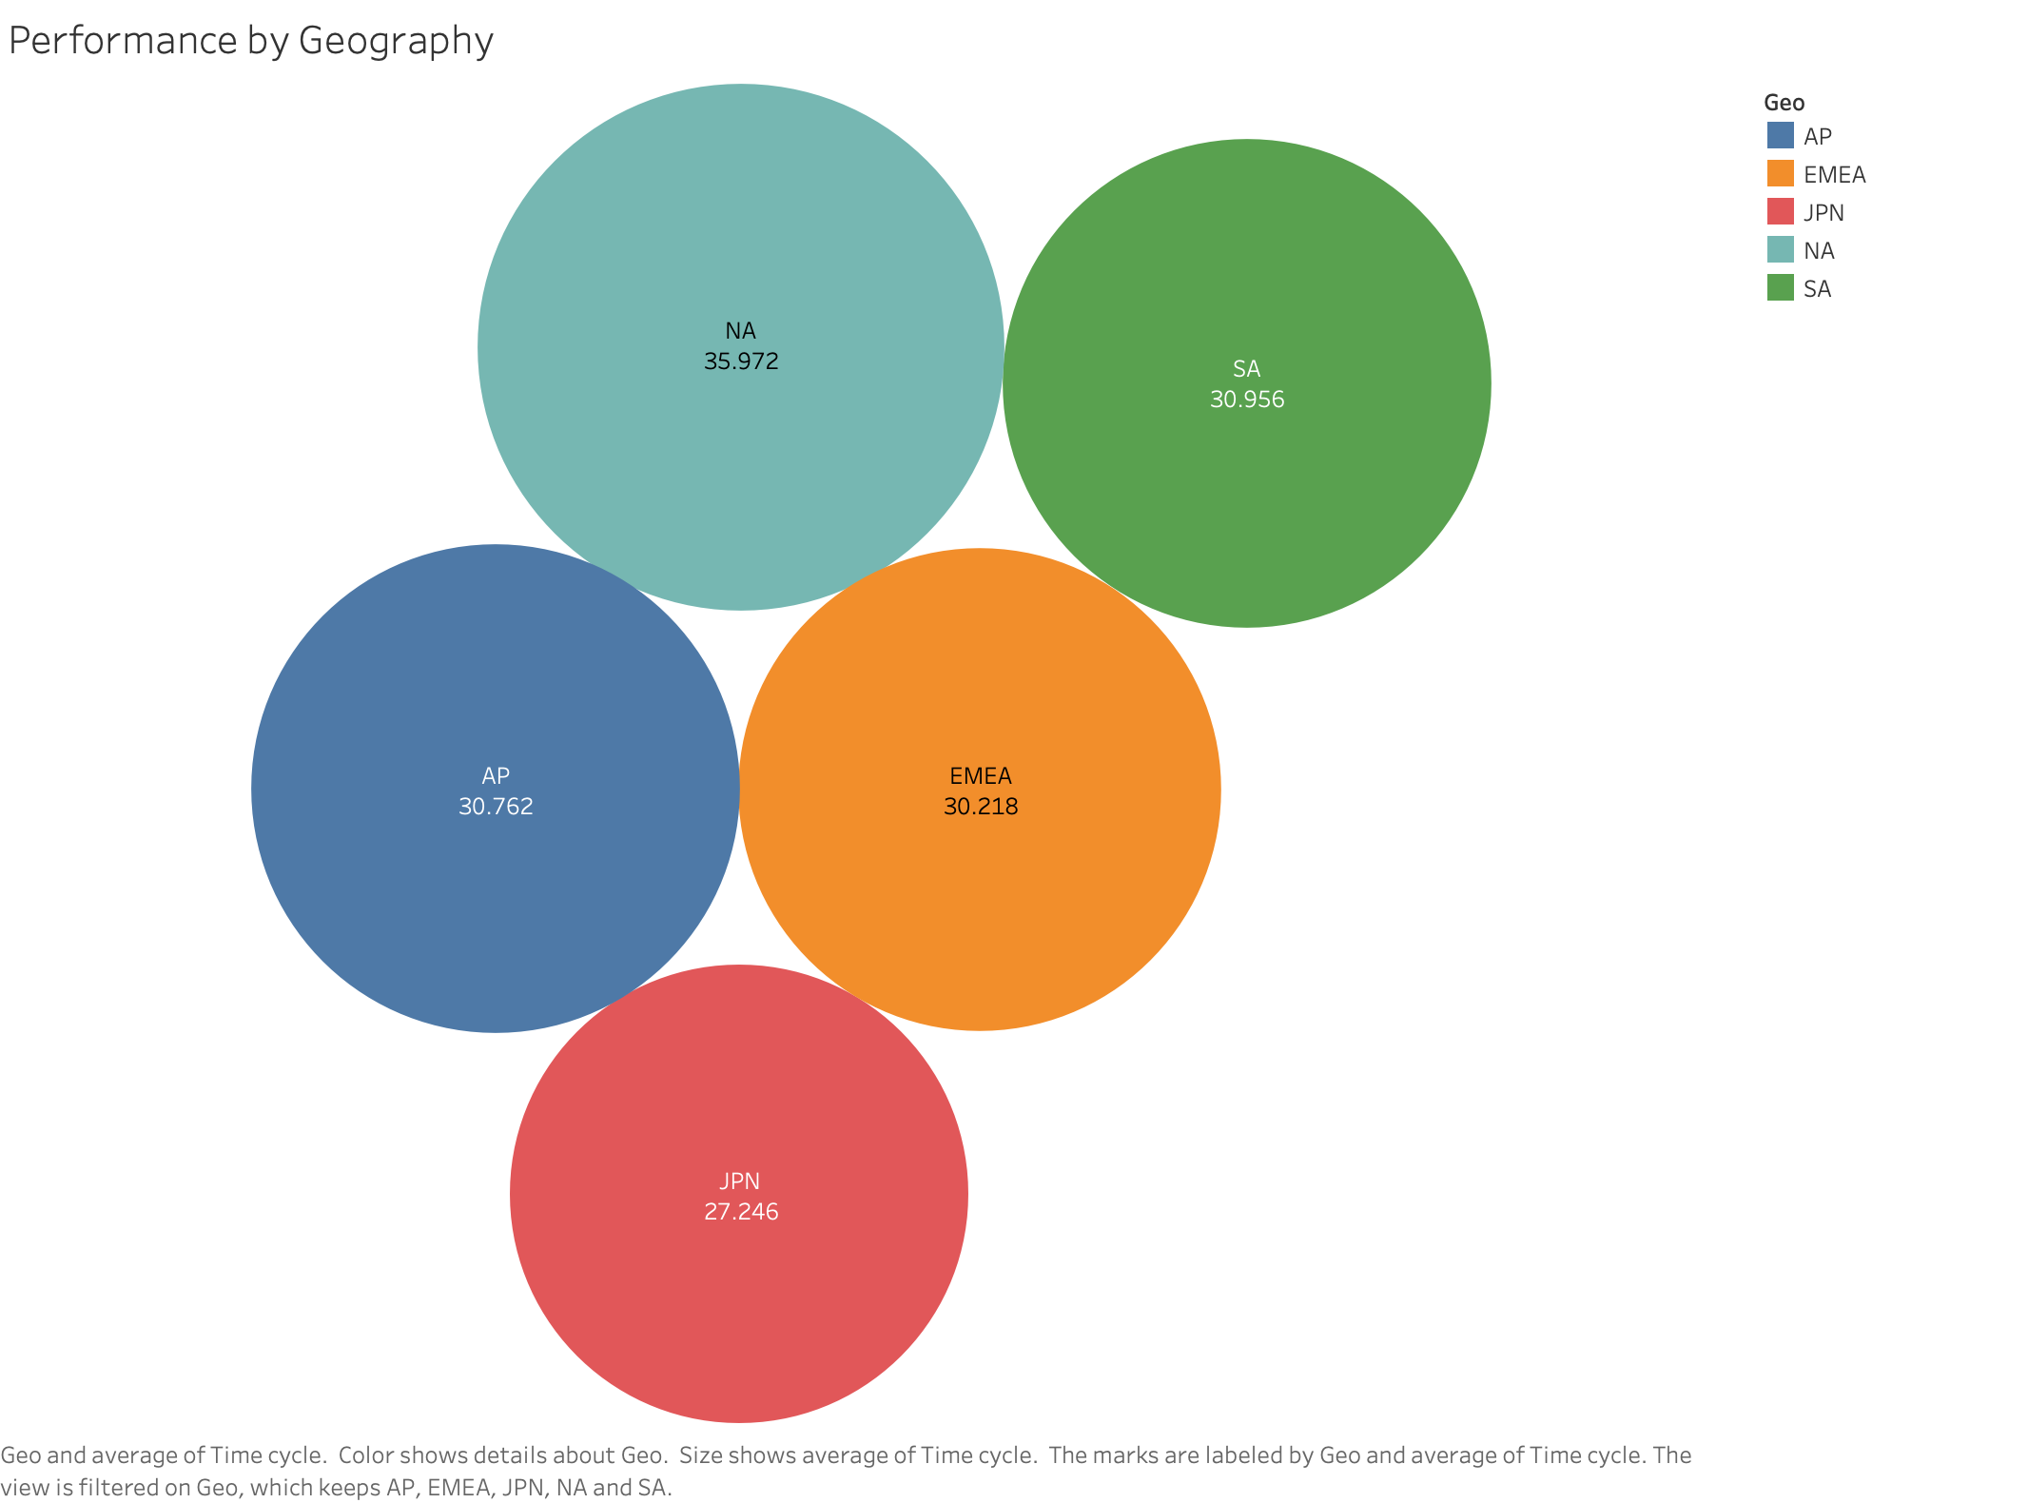
NA has the highest average cycle time over the past 3 years.
Japan is performing is good in terms of process cycle time.
Notes:
Tim-Li

Slide 25
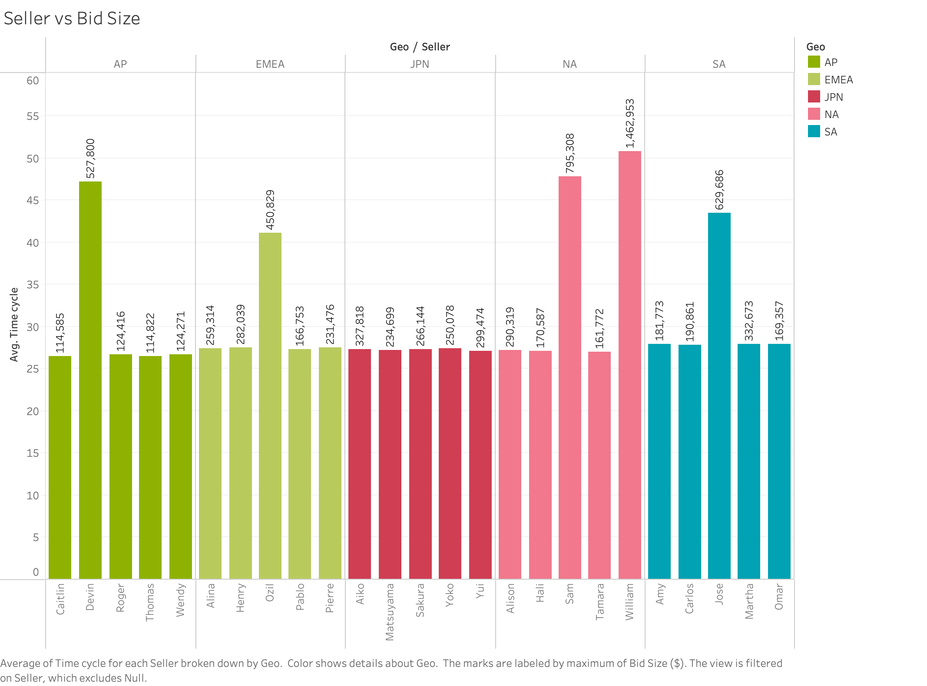
Based on the analysis, we see that William(NA Regions) has the highest time cycle for the process.
We also see that William has the highest Bid size overall.
Notes:
Tim-Li

Slide 26
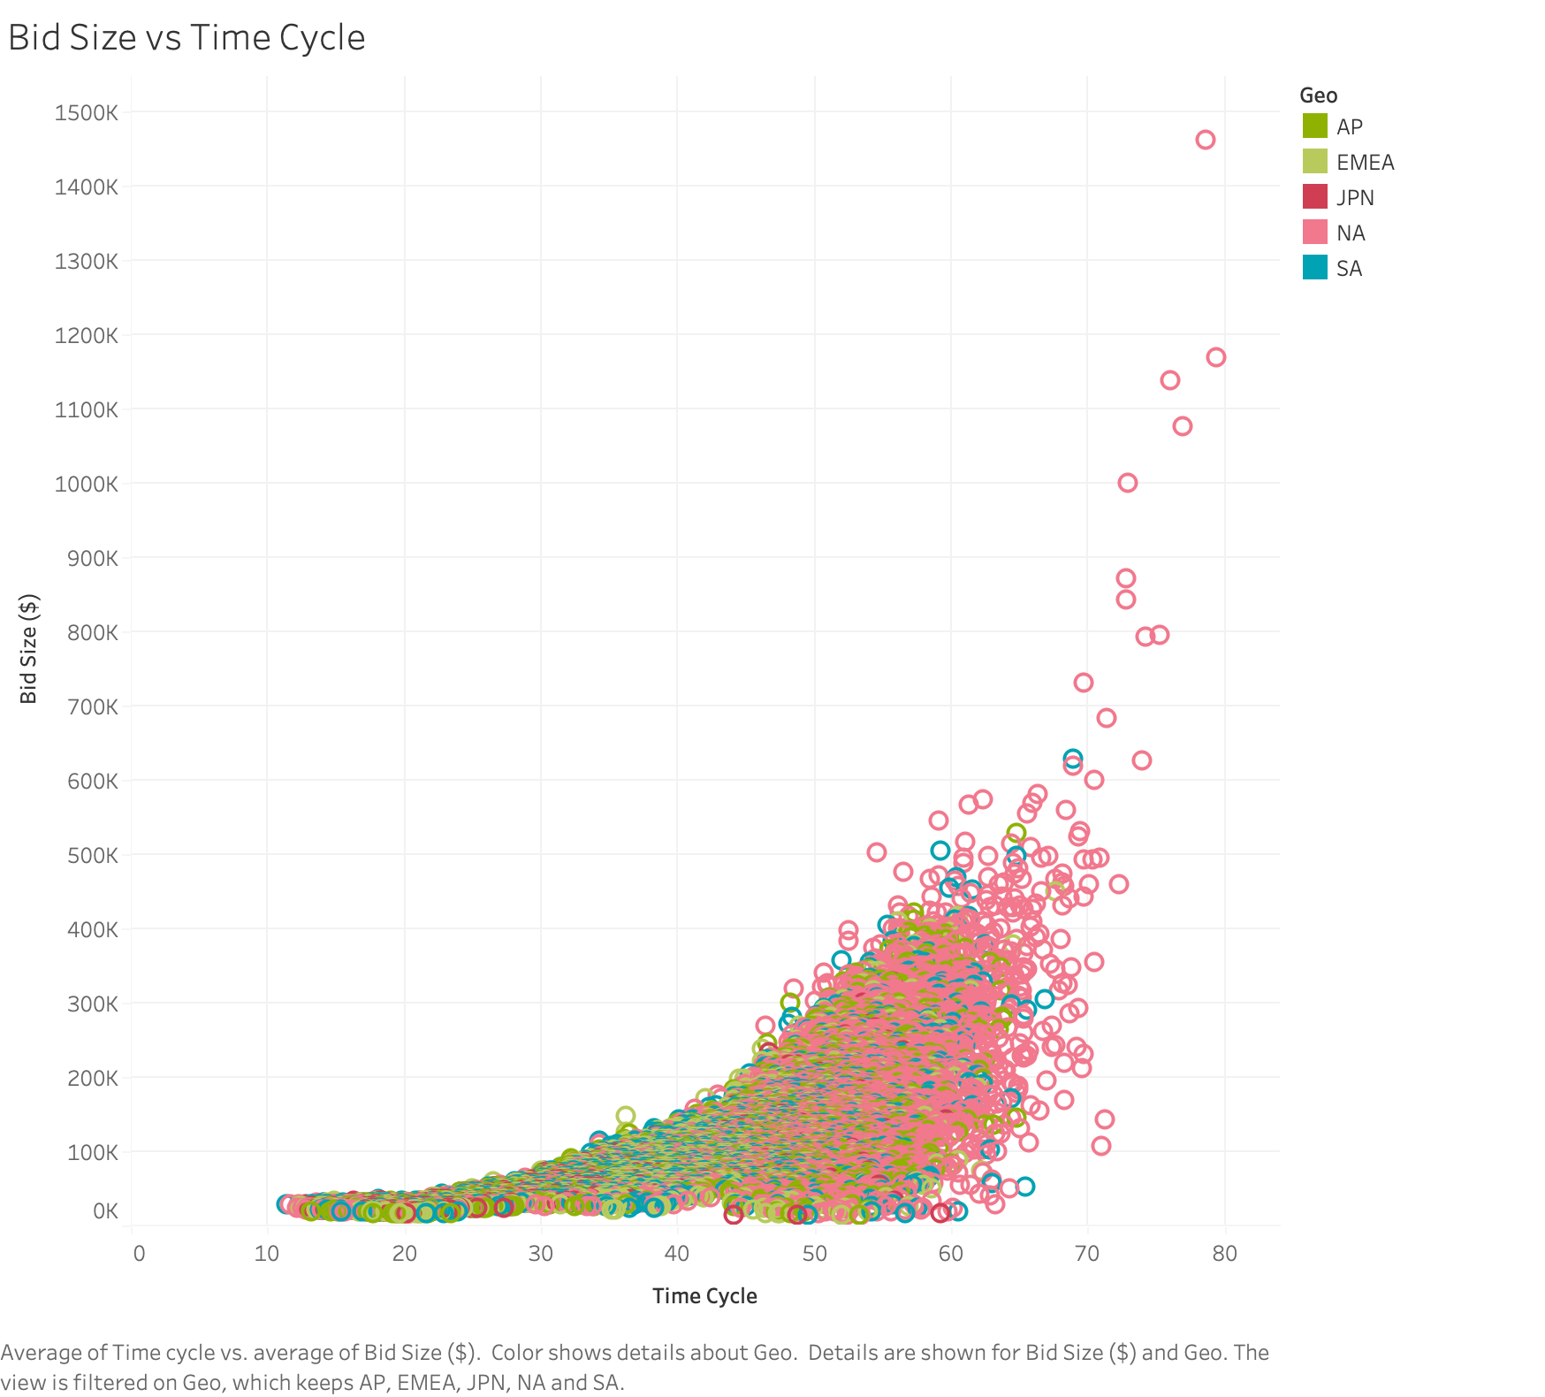
Scatter Plot

Slide 27
Analysis of the Bid Size and Time Cycle Complexity.
As the bid size is increasing, the cycle time is increasing.
North America has the highest average time cycle.
The time stamps ZQT6(The Product Design team generates a configuration comprising technical specifications, which is then reviewed for completeness by the BSS before being sent to the Seller for approval),ZQT8(The request is returned to the BSS who, after reviewing and finalizing the document, submits it for approval to the Proposal Support Manager)
William from North America has the projects with the highest bid size and greater time cycle.
Notes:
Tim-Li

Slide 28
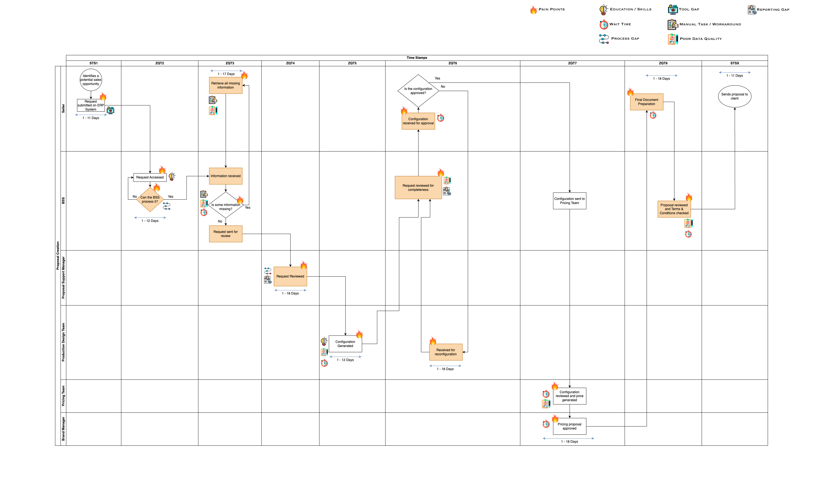
Superimposed Swimlane Process Map
Notes:
Priyanka

Slide 29
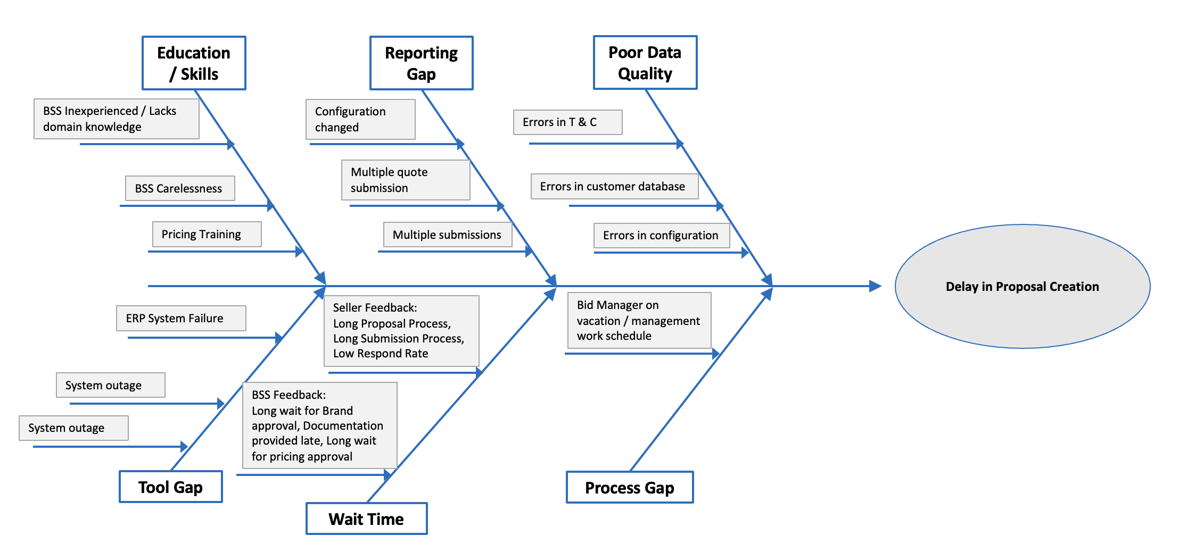
Fishbone Diagram

Slide 30
Improvement(Recommended Solution)

Slide 31
Improvement(Recommended Solution): Solution for the Concern raised by Sellers Feedback: .
Proposing a new application with a user-friendly interface and powerful AI capabilities to streamline the ERP submission process.
Notes:
Priyanka/Gayathri

Slide 32
Improvement(Recommended Solution): Solution for the Concern raised by BSS Feedback:
​ Implementing 'Poka-Yoke' methodology with mandatory and validation fields, alongside an AI program leveraging knowledge mining and bid records database access, to minimize errors and efficiently identify missing or vital client information in the request submission process.​ ​

Slide 33
Improvement(Recommended Solution):
1. To address interlinked bottlenecks stages due to configuration errors, we propose implementing a standardized configuration template as a baseline, followed by utilizing an AI system for accuracy confirmation. This strategy aims to enhance operational efficiency and effectiveness.
2. Proposing the integration of Robotic Process Automation (RPA) for document generation at ZQT8, allowing BSS agents to focus on proofreading proposals, minimizing delays, and streamlining the process before submission to the Seller.
Notes:
Priyanka/Gayathri

Slide 34
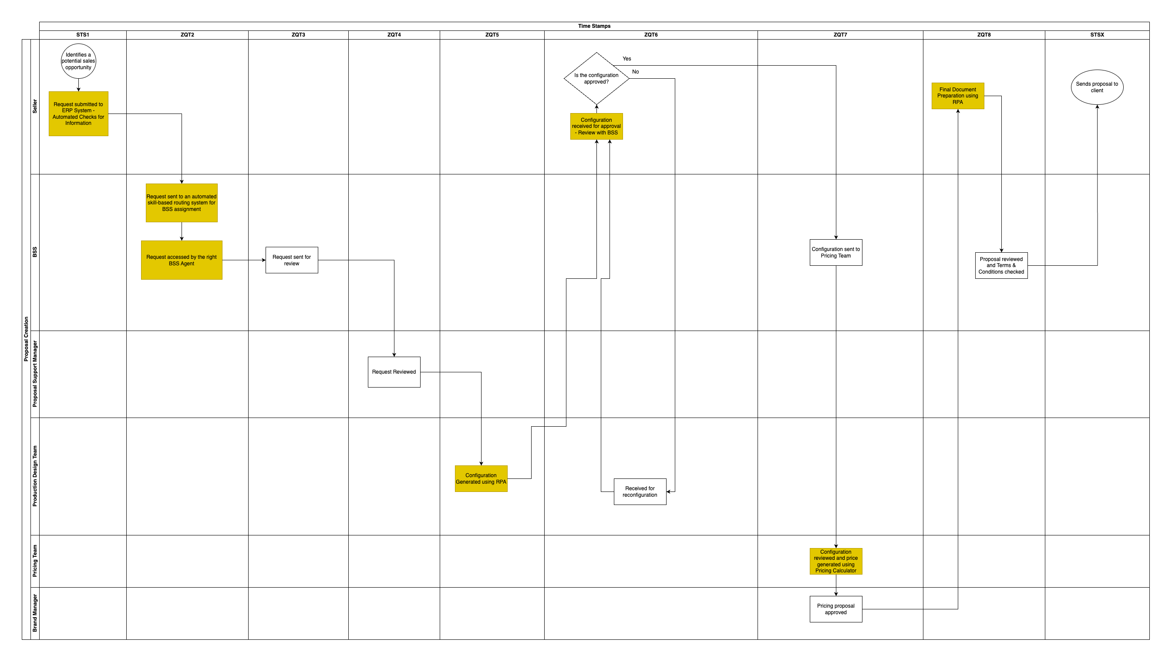
Recommended Process Map

Slide 35
Control:
Continue to invest in training for Bid Support Specialists to ensure they are proficient in using the new AI capabilities and standardized processes. Regular skill assessments can be part of this control mechanism.
Develop clear escalation protocols for any issues that may arise during the proposal creation process. This will ensure that problems are addressed promptly and effectively.
Maintain a dedicated team responsible for ongoing process improvement. This team can analyze the data and feedback collected during the Control phase to identify further opportunities for optimization.
Schedule periodic reviews at the management level to assess the effectiveness of the new processes and technology. These reviews can help ensure that the improvements are aligned with the company's strategic goals.

Slide 36
Conclusion:
Projected Savings: $1.2 Million
Current Average Cycle time : 31.6 days
Expected Average Cycle time: 26.86 days
Estimated Cost of investment in the Process Improvement:
$750,000
Notes:
Mithun

Slide 37
Thank You

